Slide 1
SILICATES
PRESENTED BY
LEELAWATI PAIKRA

Slide 2
DEFINITION
Compounds formed from silica or silicon dioxide with metals are called silicates.
Examples-sodium silicate (Na2SiO3)
Water, glass,calcium silicate (CaSiO3)

Slide 3
TYPES OF SILICATES
1 ortho silicates –willemite
2 pyro silicates –thortevetite
3 cyclic silicates – wollastonite
4 series silicates –spodumene
5 sheet silicates –mica

Slide 4
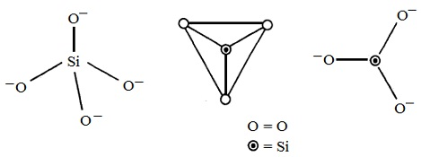
STRUCTURE OF SILICATES

Slide 5
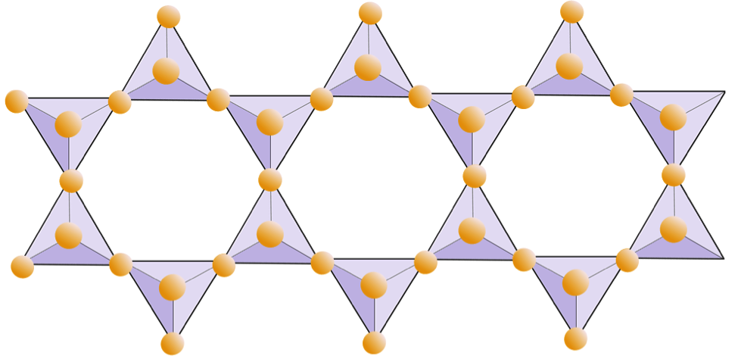
The basic repeating unit of the formation of all silicates is the (SiO4)4-.

Slide 6
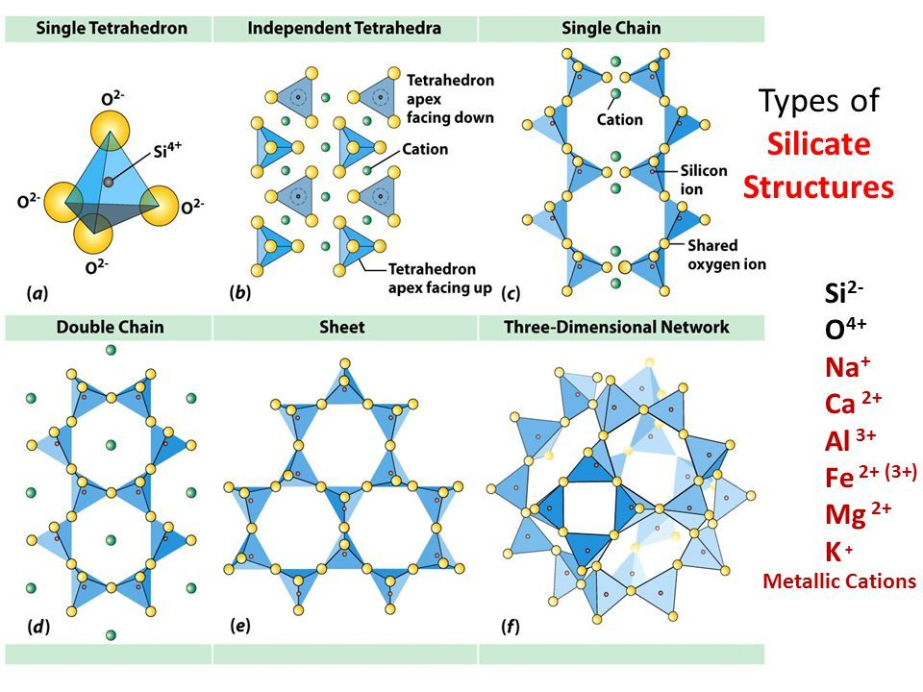
STRUCTURE OF SILICATES

Slide 7
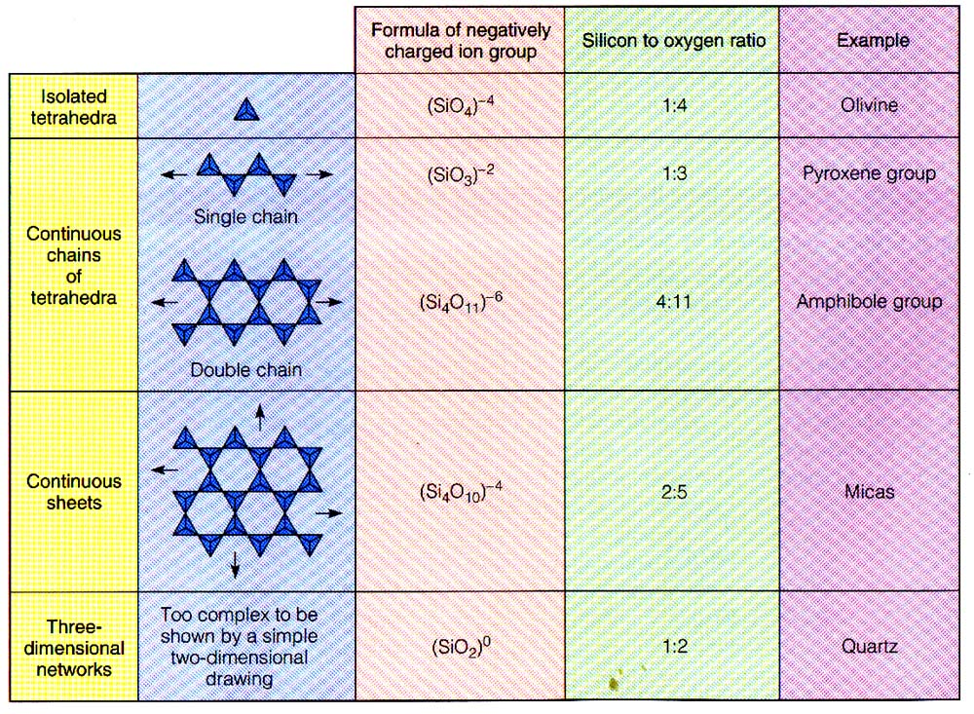

Slide 8
USES OF SILICATES
Silicates are also used to make glass and ceramics .To do so hard formless material like sand or ceramic clay is heated to high temperatures ,turning it into malleable material that can be formed to make drinking glasses.

Slide 9


